Slide 1

.NET Bootcamp

Slide 2
Overview
Intro to ASP.NET Core WebAPI
For next class

Slide 3
REST Review
Stands for Representational State Transfer
Concepts:
Separation of client and server
Server request are stateless
Cacheable requests
Uniform interface

Slide 4
HTTP Request/Response
Have 3 pieces:
Verb
Headers
Body

Slide 5
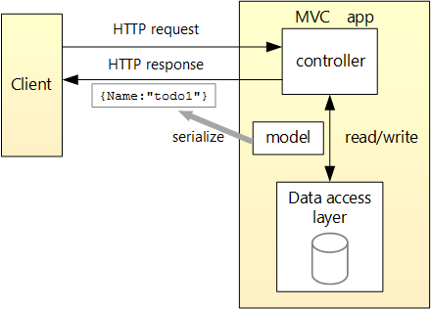
Diagram of the app

Slide 6
HTTP Verbs - Review
GET
Typically use this request to retrieve a resource
Should not modify the content
POST
Use this request to create a new resource
PUT
Use this request to update an existing resource
PATCH
Use this request to update an existing resource with a set of changes
DELETE
Use this request to remove an existing resource

Slide 7
VS Code HTTP Plugin
REST Client
https://marketplace.visualstudio.com/items?itemName=humao.rest-client

Slide 8
Building an API – Example
Todo List
Collection of TodoItems
TodoItem
Id – int
Name – string
IsComplete - bool

Slide 9
Building an API
Be explicit
Make sense of what's happening
http://.../api/Products
http://.../api/Products/1
http://.../api/Categories/Snacks
http://.../api/Categories/Snacks/Products
Naming
Use Plurals

Slide 10
URI Design
Resource | GET | POST | PUT | DELETE
/Todo | Get List of Todo Items | Create a Todo Item | Update Batch of Todo Items OR Error | Error
/Todo/1 | Get Todo Item | Error | Update Todo Item | Delete Todo Item

Slide 11
Explore WebAPI Project
startup.cs
/Data
/Models
/Controllers

Slide 12
What is Swagger?
OpenAPI Specification
Swagger is a set of tools to take full advantage of all the capabilities of the OAS
https://swagger.io/

Slide 13
Status Codes
200 – Success/Ok
400 – Bad Request
500 – Internal Error
201 – Created
304 – Not Modified
404 – Not Found
401 – Unauthorized
403 – Forbidden

Slide 14
Attributes
[HttpGet]
[HttpPost]
[HttpPut]
[HttpDelete]
[Route()]
[ApiController]
https://docs.microsoft.com/en-us/aspnet/core/web-api/?view=aspnetcore-3.1

Slide 15
Build the API!

Slide 16
For Next Class
Continue to break down your application into manageable tasks and create issues in GitHub
Build an API based off Week 6’s project

